Slide 1
Computer Security Concepts
A Definition of Computer Security
The NIST Computer Security Handbook [NIST95] defines the term computer security as follows:
COMPUTER SECURITY
The protection afforded to an automated information system in order to attain the applicable objectives of preserving the integrity, availability, and confidentiality of information system resources (includes hardware, software, firmware, information/ data, and telecommunications).

Slide 2
This definition introduces three key objectives that are at the heart of computer security:
Confidentiality: This term covers two related concepts:
Data confidentiality: Assures that private or confidential information is not made available or disclosed to unauthorized individuals.
Privacy: Assures that individuals control or influence what information related to them may be collected and stored and by whom and to whom that information may be disclosed.
Integrity: This term covers two related concepts:
Data integrity: Assures that information and programs are changed only in a specified and authorized manner.
System integrity: Assures that a system performs its intended function in an unimpaired manner, free from deliberate or inadvertent unauthorized manipulation of the system.
Availability: Assures that systems work promptly and service is not denied to authorized users.

Slide 3
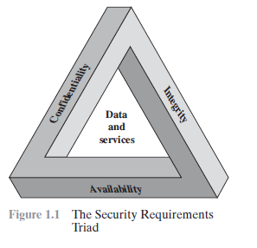
CIA Triad

Slide 4
FIPS 199 provides a useful characterization of these three objectives in terms of requirements and the definition of a loss of security in each category:
Confidentiality: Preserving authorized restrictions on information access and disclosure, including means for protecting personal privacy and proprietary information. A loss of confidentiality is the unauthorized disclosure of information.
Integrity: Guarding against improper information modification or destruction, including ensuring information nonrepudiation and authenticity. A loss of integrity is the unauthorized modification or destruction of information.
Availability: Ensuring timely and reliable access to and use of information. A loss of availability is the disruption of access to or use of information or an information system.

Slide 5
THE OSI SECURITY ARCHITECTURE
Responsibility of a security manager:
Assess effectively the security needs of an organization
Evaluate and choose various security products and policies.
So there is a need for a systematic way of defining the requirements for security and characterizing the approaches to satisfy those requirements.
ITU-T Recommendation X.800, Security Architecture for OSI, defines such a systematic approach.

Slide 6
THE OSI SECURITY ARCHITECTURE
As developed as an international standard, computer and communications vendors have developed security features for their products and services that relate to this structured definition of services and mechanisms.

Slide 7
THE OSI SECURITY ARCHITECTURE
The OSI security architecture focuses on security attacks, mechanisms, and services. These can be defined briefly as
Security attack:
Any action that compromises the security of information owned
by an organization.
Security mechanism:
A process (or a device incorporating such a process) that is
designed to detect, prevent, or recover from a security attack.
Security service:
A processing or communication service that enhances the security
of the data processing systems and the information transfers of an
organization. The services are intended to counter security attacks, and
they make use of one or more security mechanisms to provide the
service.

Slide 11
SECURITY ATTACKS
Both in X.800 and RFC 2828, security attack is classified in terms of passive attacks and active attacks.
A passive attack attempts to learn or make use of information from the system but does not affect system resources.
An active attack attempts to alter system resources or affect their operation.

Slide 12
Passive Attacks
Passive attacks are in the nature of eavesdropping on, or monitoring of, transmissions.
The goal of the opponent is to obtain information that is being transmitted.
Two types of passive attacks are the,
Release of message contents and
Traffic analysis.

Slide 13
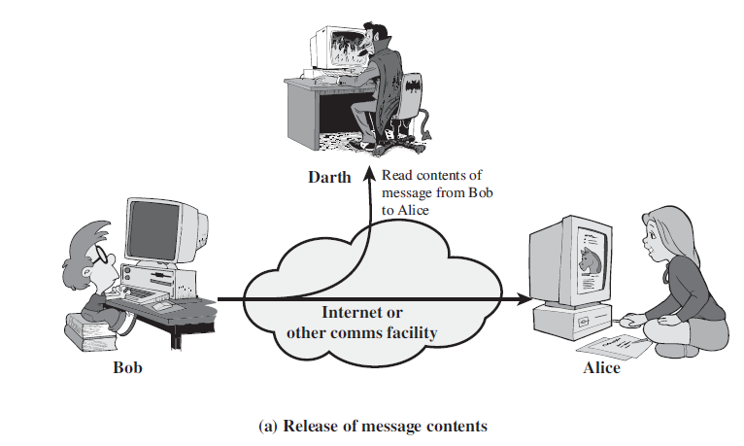
Passive Attacks - Release of message contents

Slide 14
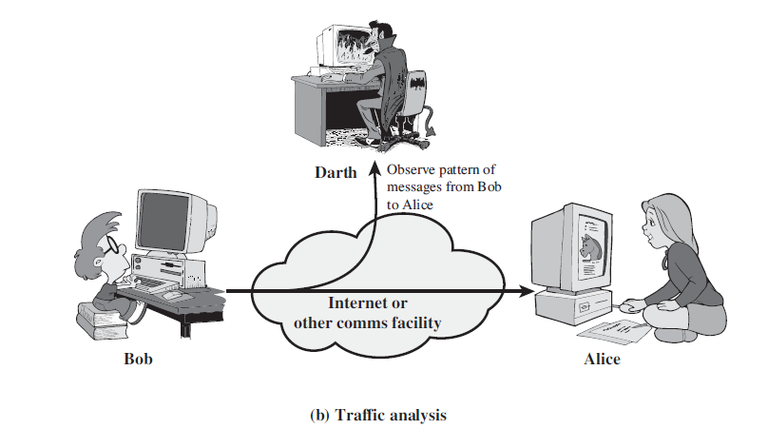
Passive Attacks – Traffic analysis
To determine the location and identity of communicating hosts .
To observe the frequency and length of messages being exchanged.
This information might be useful in guessing the nature of the communication
that was taking place.

Slide 15
PASSIVE ATTACKS - CHARACTERISTICS
Passive attacks are very difficult to detect, as they do not involve any alteration of the data.
Message traffic is sent and received in normal fashion, and neither the sender nor receiver is aware that a third party has read the messages or observed the traffic pattern.
However, it is feasible to prevent the success of these attacks, usually by means of encryption.
Thus, the emphasis in dealing with passive attacks is on prevention rather than detection.

Slide 16
Active Attacks
Active attacks involve some modification of the data stream or the creation of a false stream and can be subdivided into four categories:
Masquerade
Replay
Modification of messages, and
Denial of service.

Slide 17
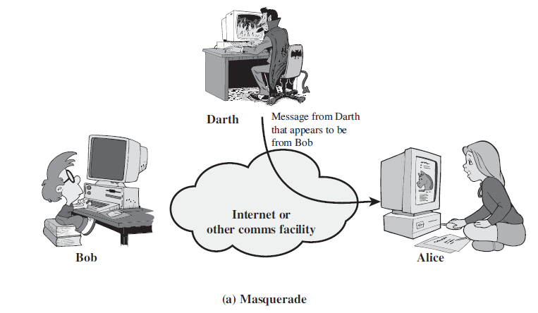
Active Attacks - Masquerade
One entity pretends to be a different entity.

Slide 18
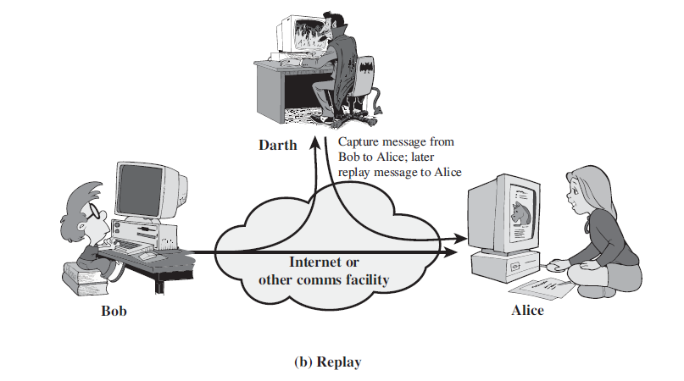
Active Attacks - Replay
Passive capture of a data unit and its subsequent retransmission to produce an unauthorized effect

Slide 19
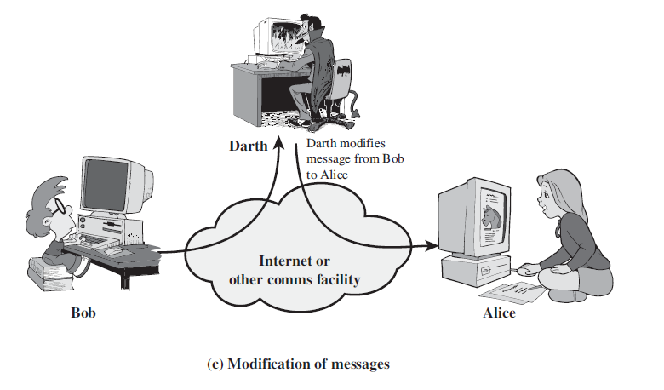
Active Attacks - Modification of messages
Some portion of a legitimate message is altered, or that messages are delayed or reordered, to produce an unauthorized effect

Slide 20
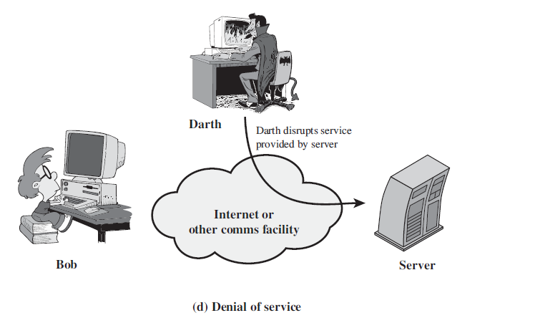
Active Attacks - Denial of service
Prevents or inhibits the normal use or management of communications facilities
Breaking all the network provided by the server.

Slide 21
Active Attacks - Characteristics
It is quite difficult to prevent active attacks absolutely because of the wide variety of potential physical, software, and network vulnerabilities.
Instead the goal is to detect active attacks and to recover from any disruption or delays caused by them.

Slide 22
SECURITY SERVICES
Services: Some of the techniques used for providing the security.
X.800 defines a security service as a service that is provided by a protocol layer of communicating open systems and that ensures adequate security of the systems or of data transfers.
RFC 2828, which provides the following definition: a processing or communication service that is provided by a system to give a specific kind of protection to system resources; security services implement security policies and are implemented by security mechanisms.

Slide 23
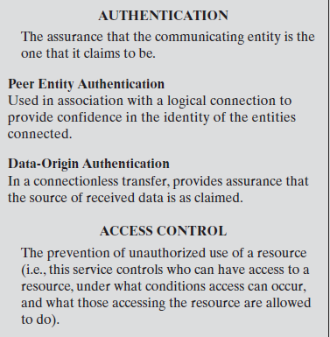
SECURITY SERVICES

Slide 24
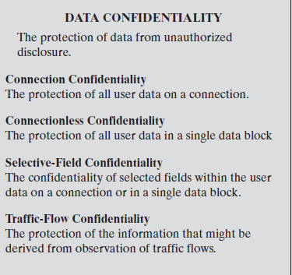
SECURITY SERVICES
Notes:
Z ,ki8uu8ijk,,juvc4crv v ,njhbv5vbyhjmklio898888888888888888888888iii879ioklooooooooop-[=;;;lllllllllllllllko09i888889ki889op’ }+&^bgtddddddddddfrrrrrrrrrrrrrrrrr
[ rrrrrrrrrrrrrrrrrrrrrrrrrrt6

Slide 25
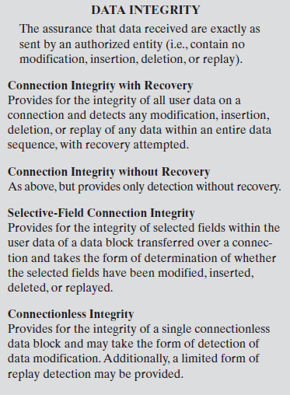
SECURITY SERVICES

Slide 26
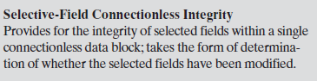
SECURITY SERVICES

Slide 27
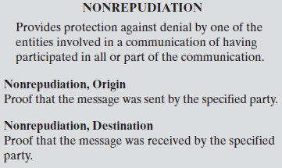
SECURITY SERVICES

Slide 28
SECURITY MECHANISMS
A security mechanism is a process (or a device incorporating such a process) that can be used in a system to implement a security service that is provided by or within the system.
According to X.800, security mechanisms can be classified into,
Specific security mechanisms
mechanisms that are implemented in a specific protocol layer, such as TCP or an application-layer protocol
Pervasive security mechanisms
mechanisms that are not specific to any particular
protocol layer or security service.

Slide 29
SPECIFIC SECURITY MECHANISMS
Encipherment
The use of mathematical algorithms to transform data into a form that is not readily intelligible. The transformation and Subsequent recovery of the data depend on an algorithm and zero or more encryption keys.
Digital Signature
Data appended to, or a cryptographic transformation of, a data unit that allows a recipient of the data unit to prove the source and integrity of the data unit and protect against forgery (e.g., by the recipient).-

Slide 30
SPECIFIC SECURITY MECHANISMS
Access Control
A variety of mechanisms that enforce access rights to resources.
Data Integrity
A variety of mechanisms used to assure the integrity of a data unit or stream of data units.

Slide 31
SPECIFIC SECURITY MECHANISMS
Authentication Exchange
A mechanism intended to ensure the identity of an entity by means of information exchange.
Traffic Padding
The insertion of bits into gaps in a data stream to frustrate traffic analysis attempts.
Routing Control
Enables selection of particular physically secure routes for certain data and allows routing changes, especially when a breach of security is suspected.
Notarization
The use of a trusted third party to assure certain
properties of a data exchange.

Slide 32
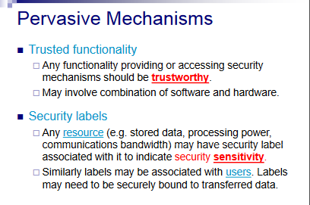

Slide 33
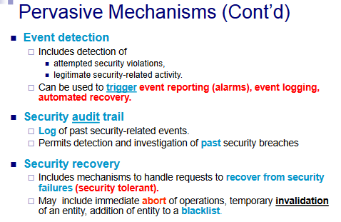

Slide 34
SECURITY FUNCTIONAL REQUIREMENTS
Access Control
Awareness and Training
Audit
Certification, Accreditation, and Security Assessments: and Accountability
Configuration Management:
Contingency Planning
Identification and Authentication:
Incident Response
Maintenance:
Media Protection
Physical and Environmental Protection

Slide 35
Planning:
Personnel Security
Risk Assessment
Systems and Services Acquisition
System and Communications Protection
System and Information Integrity

Slide 36
Security functional requirements
Access Control:
Limit information system access to
authorized users,
processes acting on behalf of authorized users, or devices
types of transactions and functions that authorized users are permitted to exercise.

Slide 37
Security functional requirements
Awareness and Training:
(i) Ensure that managers and users of organizational information systems are made aware of the security risks associated with their activities.
(ii) Ensure that personnel are adequately trained to carry out their assigned information security-related duties and responsibilities.

Slide 38
Security functional requirements
Audit and Accountability:
(i) Create, protect, and retain information system audit records
(ii) Ensure that the actions of individual information system users can be uniquely traced to those users so they can be held accountable for their actions.

Slide 39
Security functional requirements
Certification, Accreditation, and Security Assessments:
(i) Periodically assess the security controls in organizational information systems to determine if the controls are effective in their application;
(ii) Develop and implement plans of action designed to correct deficiencies and reduce or eliminate vulnerabilities in organizational information systems;

Slide 40
Security functional requirements
Configuration Management:
(i) Establish and maintain baseline configurations
(ii) Establish and enforce security configuration settings for information technology products employed in organizational information systems.

Slide 41
Security functional requirements
Contingency Planning:
Establish, maintain, and implement plans for,
Emergency response,
backup operations, and
post disaster recovery
to ensure the availability of critical information resources and continuity of operations in emergency situations.

Slide 42
Security functional requirements
Identification and Authentication:
Identify information system users, processes acting on behalf of users, or devices,
Authenticate (or verify) the identities of those users, processes, or devices,

Slide 43
Security functional requirements
Incident Response:
(i) Establish an operational incident-handling capability for organizational information systems that includes adequate preparation, detection, analysis, containment, recovery, and user-response activities; and
(ii) track, document, and report incidents to appropriate organizational officials and/or authorities.
Maintenance:
(i) Perform periodic and timely maintenance on organizational information systems; and
(ii) provide effective controls on the tools, techniques, mechanisms, and personnel used to conduct information system maintenance.

Slide 44
Security functional requirements
Media Protection:
(i) Protect information system media, both paper and digital;
(ii) limit access to information on information system media to authorized users; and
(iii) sanitize or destroy information system media before disposal or release for reuse.

Slide 45
Security functional requirements
Physical and Environmental Protection:
(i) Limit physical access to information systems, equipment, and the respective operating environments to authorized individuals;
(ii) protect the physical plant and support infrastructure for information systems;
(iii) provide supporting utilities for information systems;
(iv) protect information systems against environmental hazards; and
(v) provide appropriate environmental controls in facilities containing information systems.

Slide 46
Security functional requirements
Personnel Security:
(i) Ensure that individuals occupying positions of responsibility within organizations (including third-party service providers) are trustworthy and meet established security criteria for those positions;
(ii) Ensure that organizational information and information systems are protected during and after personnel actions such as terminations and transfers; and
(iii) Employ formal sanctions for personnel failing to comply with organizational security policies and procedures.

Slide 47
Planning:
Develop, document, periodically update, and implement security plans for organizational information systems.
Risk Assessment:
Periodically assess the risk to organizational operations.

Slide 48
Systems and Services Acquisition:
(i) Allocate sufficient resources to adequately protect organizational information systems;
(ii) employ system development life cycle processes that incorporate information security considerations;
(iii) employ software usage and installation restrictions; and
(iv) ensure that third party providers employ adequate security measures to protect information, applications, and/or services outsourced from the organization.

Slide 49
System and Communications Protection:
(i) Monitor, control, and protect organizational communications at the external boundaries and key internal boundaries of the information systems; and (ii) employ architectural designs, software development techniques, and systems engineering principles that promote effective information security within organizational information systems.

Slide 50
System and Information Integrity:
(i) Identify, report, and correct information and information system flaws in a timely manner;
(ii) provide protection from malicious code at appropriate locations within organizational information systems; and
(iii) monitor information system security alerts and advisories and take appropriate actions in response.

